Slide 1






Check what
AI writes
A 60 minute session on your team's own work.
Notes:
Welcome, about 3 minutes (guide page 6). This hour is about one habit: checking what AI hands you before it goes anywhere. That's what it writes, the sources it cites, and the changes it makes to your files. We'll practise it on your own work, in three habits: spot what could be invented, check it outside the chat, ask what was checked. Nobody is being tested. Ask everyone to open their real task and their AI tool now. Hand out the handout.

Slide 2

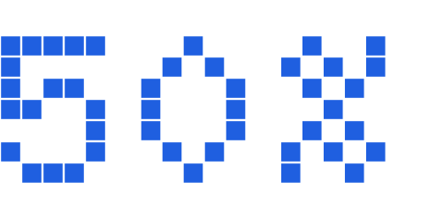



Checking came top.
chose quality control of AI output, top of the list of human skills that matter more as AI takes on work.
said they rely on AI output without evaluating its accuracy, in the study's section on AI at work.
And the work now arrives as cited reports, and as edits made straight into shared files.
Notes:
Why it matters now, about 2 minutes (guide page 6). Say: Checking came top. In Microsoft's 2026 Work Trend Index, a survey of 20,000 people who use AI at work in 10 countries, quality control of AI output topped the list of human skills that matter more as AI takes on work: 50% chose it. In a global study by the University of Melbourne and KPMG, in its section on AI at work, 66% said they rely on AI output without evaluating its accuracy, and 56% have made mistakes in their work because of AI. Keep it accurate: two skills topped the list, quality control of AI output (50%) and critical thinking (46%). Say in this survey, not everyone. Microsoft sells AI tools and the figures are self-reported. The Melbourne study ran from November 2024 to January 2025. Then: the work now arrives as cited reports, and as edits made straight into shared files. We'll practise both. First, the classic case, from 2023.

Slide 3


In 2023, a lawyer asked
ChatGPT for court cases
to support his argument.
It gave him six that looked real, with names, dates and quotes from the judges.
Neosaipien is not affiliated with Anthropic, OpenAI or Google.
Notes:
The classic case, from 2023, about 3 minutes across slides 3 to 5 (guide page 7). Say: In 2023, a lawyer asked ChatGPT for court cases to support his argument. It gave him six that looked real, with names, dates and quotes from the judges. Keep it accurate: say a lawyer, no names. Six is the number of invented cases, not everything it gave him. Neosaipien is not affiliated with Anthropic, OpenAI or Google.

Slide 4
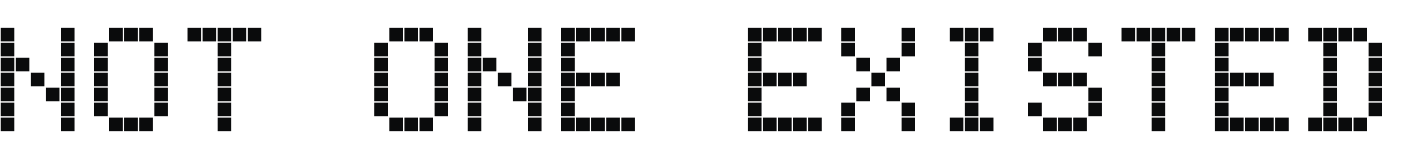
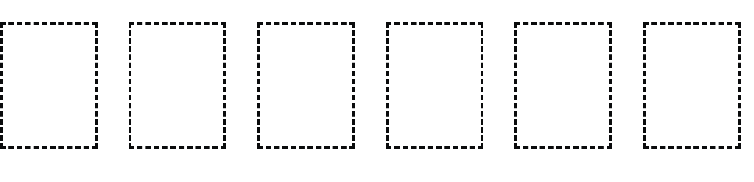

They went to a federal judge, and
Notes:
Say: They went to a federal judge, and not one of them existed. Pause on it. Don't add what happened to him afterwards.

Slide 5

When he asked whether the cases were real, he was asking the same machine.
It said yes.
Notes:
Say: When he asked whether the cases were real, he was asking the same machine. It said yes. Don't say when he asked or why: the court record doesn't settle it. Then ask the room: What would you have checked, and where? Take two answers and say you'll come back to it at the end. If someone says the story is old: yes, it's from 2023, which is why it's the classic case. The tools have changed since; the habit hasn't.

Slide 6


The AI wasn't lying.
It writes a likely answer, one word at a time. And likely isn't the same as true.
Name v. Name
A court
A year
A confident quote
Notes:
Why it happens, slides 6 and 7, about 4 minutes (guide page 7). Say: The AI wasn't lying. It was guessing. It writes a likely answer, one word at a time. It knows what a court case looks like: two names with a v in the middle, a court, a year, and a confident quote. So it wrote a likely version of that. And likely isn't the same as true. This framing is ours, based on how the makers describe their models. It isn't what the court said.

Slide 7
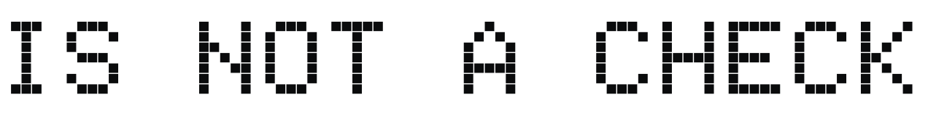

Are you sure?
It's the same machine vouching for its own answer.
The original document
A source you trust
A person free to disagree
Notes:
Say: Asking it, are you sure, isn't checking. It's the same machine vouching for its own answer. Check outside the chat: the original document, a source you trust, or a person free to disagree. Don't say AI can't check anything, or never ask again: a fresh chat or a second look against a pasted source is a different thing.

Slide 8











Spot what could be invented
Run your real task, or use an answer you already have.
Underline every name, number, date, quote, source and link.
Mark each one. K: I know it's right. S: I know the source. ?: I can't tell.
Check the two that would hurt most if wrong, outside the chat.
Tell your neighbour one thing you found.
Don't ask the AI to check itself. Go to the source.
Notes:
Exercise 1, about 11 minutes (guide page 8). Read the steps aloud, then start the timer. Before step 4 say: Don't ask the AI to check itself. Go to the source. After step 5 ask: Who found something they couldn't check? No AI tool or a confidential task: use practice sheet 1, steps 2 and 3 on the summary only.

Slide 9















Check a summary against its source
Get a summary of a document you're allowed to share, or use practice sheet 1.
Read it beside the source. Mark each difference M, C or A.
Rewrite the sentence that would cause the most trouble. Compare with your neighbour.
Teams that work with numbers: use practice sheet 4.
Notes:
Exercise 2, about 10 minutes (guide page 8). Steps: 2 minutes to get a summary, 5 to read it beside the source and mark M, C or A, 3 to rewrite the worst sentence and compare. Say: Don't ask, is this right? Ask what's missing, what's changed, what's added. A quote you can't find in the source counts as added. A team that works with numbers uses practice sheet 4 instead. Answers are in the guide (page 10 for sheet 1, page 20 for sheet 4).

Slide 10







An AI turned OpenAI's proof on a famous problem about how water flows into code a computer can check, and the check passed.
So three mathematicians laid that proof's code beside its paper, to see if the two matched. They didn't.
In at least two places, the code went its own way. They're not saying the written proof is wrong, only that the pass can't tell you if it's right.
Neosaipien is not affiliated with Anthropic, OpenAI or Google.
Notes:
Check what it did, about 3 minutes across slides 10 and 11 (guide page 11). Say: One more story, from this year. In September 2026, an AI turned OpenAI's proof on a famous problem about how water flows into code that a computer can check, and the computer check passed. So three mathematicians laid that proof's code beside its paper, to see if the two matched. They didn't. In at least two places, the code went its own way. In one, it proved less than the paper claimed. Which means the computer had checked a different proof of the same result, not the one on paper. They're not saying the written proof is wrong, only that the pass can't tell you if it's right. Keep it accurate: their paper is a preprint, not peer reviewed. Don't say the proof is wrong or solved. Don't name the mathematicians.

Slide 11

Check what it did, not just what it wrote.
Does each source say what the report claims?
What did it change, and was that asked for?
A source in square brackets is a place to look, not a check.
The version history shows what it did.
Notes:
Say: So when an AI tells you its work passed a check, ask what was checked. AI work now comes in two shapes that need it. A report with sources: the sources look like proof, but a source in square brackets is a place to look, not a check. Does each source say what the report claims? An edit to a shared file: what did it change, and was that asked for? The version history shows what it did. Keep this slide clear of dates and sources: the line is our advice, not the preprint's finding.

Slide 12















Trace a cited report
1 min. Who will see it? Decide how much to check.
1 min. Number every claim that can be checked.
4 min. Open each source. Mark each claim Y, P or N.
1 min. Underline the words that keep it true.
1 min. Fill in one row of the log.
1 min. It says its sources were checked. What was checked?
Y: the source says it. P: only part of it. N: it doesn't say it.
Notes:
Exercise 3, part A, about 9 minutes (guide page 12). Pairs use practice sheet 2. Read the steps aloud and start the timer. The routine: Sort, List, Trace, Hedge, Log, then ask what was checked. Say: A source in square brackets isn't a check. It's a place to look. Trace means you read the source itself, not the AI's summary of it. Watch for pairs who see that a source exists and move on: ask, but does it say that? Two claims don't match their sources. Answers are on guide page 16.

Slide 13













Find what an AI changed
Read the request. What was the AI asked to do?
Compare the two versions, line by line. Mark W, C, M or A.
Was each change asked for? Would anyone have seen it?
Keep, fix or restore. Who checks AI edits to our files?
Practice sheet 3, or your own file's version history.
Notes:
Exercise 3, part B, about 7 minutes (guide page 12). Pairs use practice sheet 3, or the shared file you set up. Say: This time it didn't write you an answer. It changed the file everyone works from. The version history is where you see what it did. Watch for pairs who only mark the wording: point at line 1 and at the line that's gone. Three of the six changes alter the meaning, and none was asked for.

Slide 14






What did you find today that you'd have missed last week?
Which parts of our work need checking every time, and which are fine with a quick read?
Where do we check things outside the chat: which document, which system, which person?
When AI hands us a report or changes our files, who checks it, and how?
Notes:
Debrief, about 6 minutes (guide page 17). Pick three of the four questions. Then go back to the classic case: What would you have checked, and where? Ask whether the answers have changed since the start. Checking every word isn't the aim; checking the parts that matter is. That's what Sort is for.

Slide 15



Type your team's habit here, in one sentence. Everyone writes it on their handout.
The habit goes round by email the next working day. We'll see how it's holding in two weeks.
Notes:
One team habit, about 2 minutes (guide page 17). Agree one sentence and type it into the white box on this slide, or write it on the board. Everyone copies it onto their handout. If the room is stuck, offer: Anything with a name, number, date or quote gets checked against its source before it leaves the team. Close with: Check outside the chat. Hand out the feedback form. Send the follow-up email the next working day, and the habit check in two weeks (guide page 18).

